Slide 1
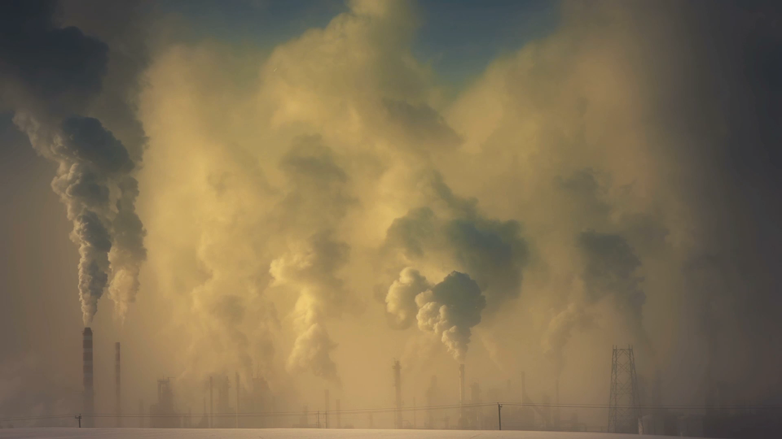
CO2 Emission Trends

Slide 2
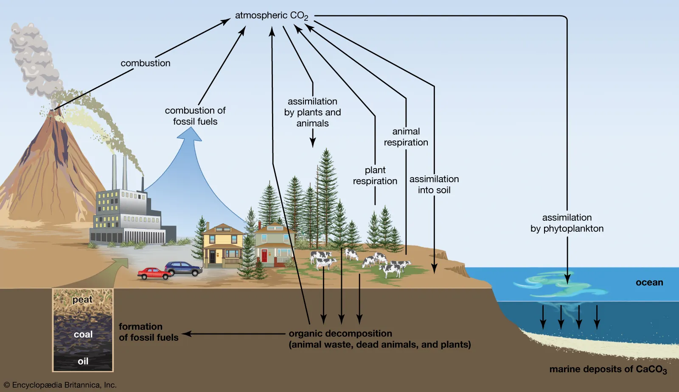
What is Climate Change?
Climate change refers to long-term shifts in temperatures and weather patterns.
Climate changes may be natural, such as through variations in the solar cycle. Since the 1800s, human activities have been the main driver of climate change, primarily due to burning fossil fuels such as coal, oil and gas.
Burning fossil fuels generates greenhouse gas emissions that act like a blanket wrapped around the Earth, trapping the sun’s heat and raising temperatures.
Examples of greenhouse gas emissions that are causing climate change include carbon dioxide and methane.
Energy, industry, transport, buildings, agriculture and land use are among the main contributors to greenhouse gas emissions.

Slide 3
The Paris Agreement
The Paris Agreement is a legally binding international treaty on climate change. It was adopted by 196 Parties at the 21st Conference of the Parties in Paris, on 12 December 2015 and entered into force on 4 November 2016.
Its goal is to limit global warming to well below 2, preferably to 1.5 degrees Celsius, compared to pre-industrial levels.
To achieve this long-term temperature goal, countries aim to reach global peaking of greenhouse gas emissions as soon as possible to achieve a climate neutral world by mid-century.
The Paris Agreement is a landmark in the multilateral climate change process because, for the first time, a binding agreement brings all nations into a common cause to undertake ambitious efforts to combat climate change and adapt to its effects.

Slide 4
Dataset Selection and Exploration
The main goal of the project was to predict if the Paris Agreement would be achieved by analyzing the trends of CO2 emissions.
The Paris Agreement states that the goal for CO2 emissions should be at least a 40% reduction by 2030 compared to 1990 CO2 levels (approx. 22 millions MtCO2).
The dataset was obtained from Kaggle and was provided by CICERO Center for International Climate Research.
The dataset contained total CO2 Emissions (MtCO2) from coal, oil, gas, cement, flaring, other sources, and per capita with > 60,000 rows of data collected from 1750 to 2022.
To begin analysis of the dataset, it was imported into a PostgresSQL database in PgAdmin4 using Amazon Web Services (RDS, S3, EC2), Google Colab, and PySpark.

Slide 5
Analysis
Linear Regression
Unsupervised Machine Learning
Deep Neural Network

Slide 6
Linear Regression
Linear Regressions were made for 4 different timeframes
1750-2021
1900-2021
2000-2021
1980-2021

Slide 7
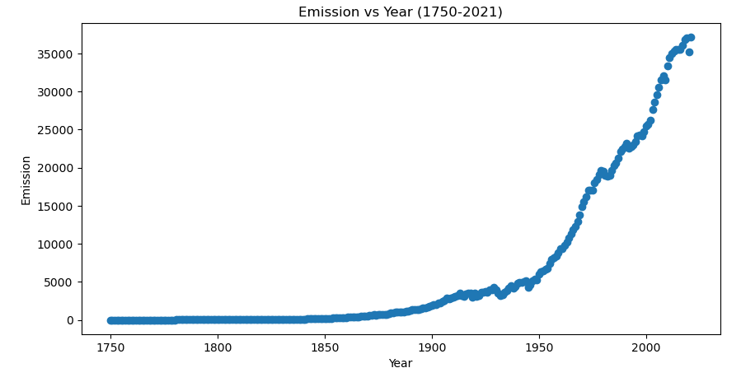
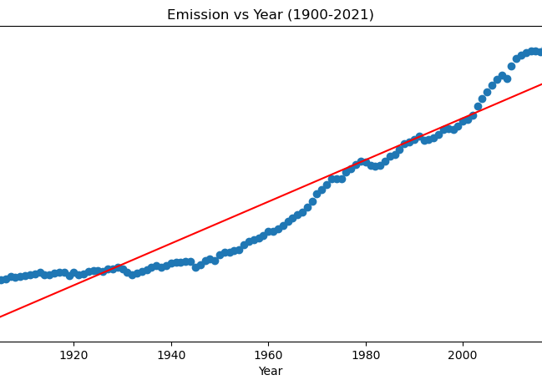
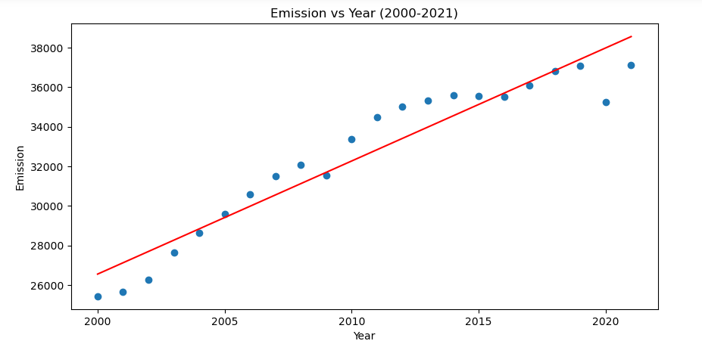
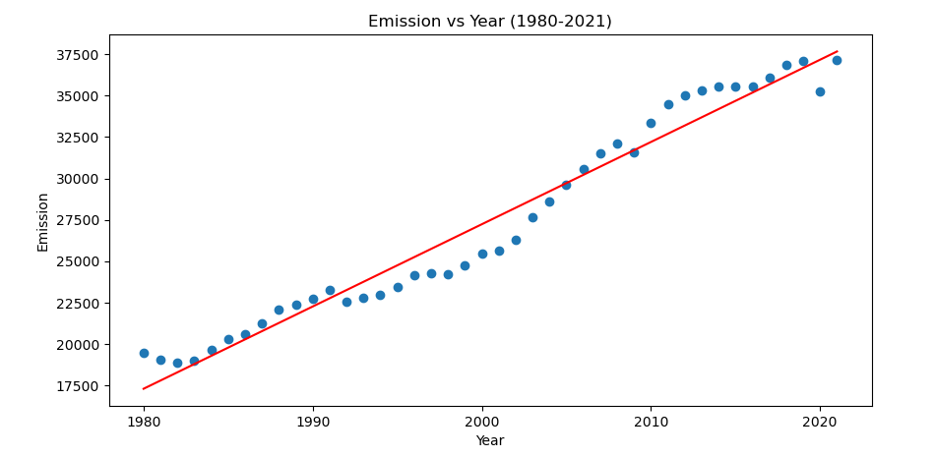
Timeframes Comparison
Exponential Regression Needed

Slide 8
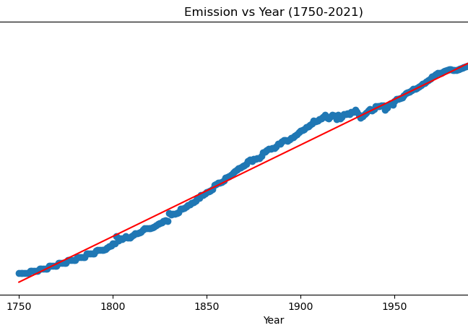
Timeframes Comparison
R2=0.987
R2=0.907
R2=0.914
R2=0.964

Slide 9
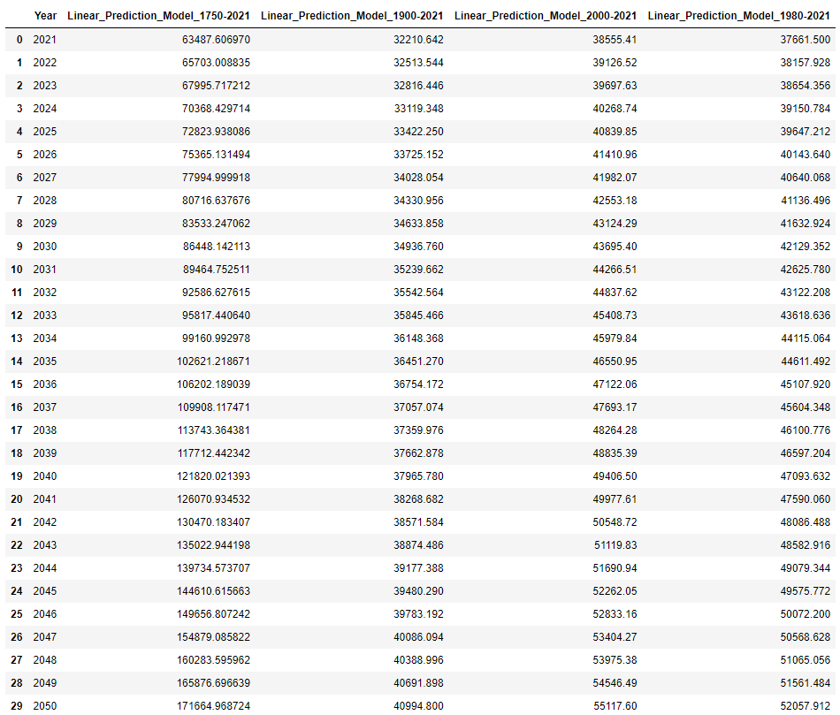










Prediction Model Results
Actual Emission in 2021 per our dataset : 37,123.85 million MtCO2
The 2000-2021 and 1980-2021 quite close in terms of predictions, signs of a constant growth rate for the last 40 years.

Slide 10
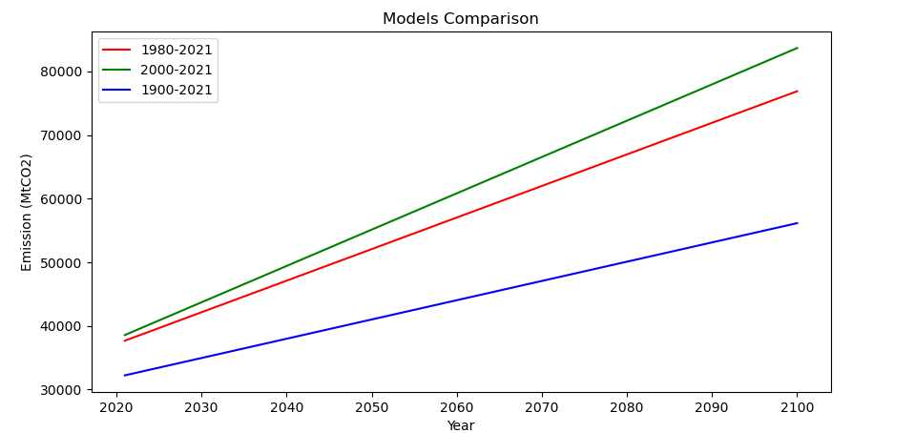
Model Comparison (Removing Exponential Outlier)
Since 1900 the emission growth rate has drastically increased. The predicted emission shifted upward over the years.
The graphs shows that the emission level does seems to want to plateau in term of growth rate.
All graphs shows that the CO2 level will keep increasing with the current global emission rate. This is true for all 3 predictions.
Hence, we will not meet the Paris Accord Goal of around ~16000 MtCO2 by 2030 (assuming same trend).

Slide 11
Unsupervised Machine Learning
By grouping countries together, we can identify large emitting countries quickly and target them to reduce emissions the most.
Utilize unsupervised learning techniques, specifically K-means clustering. We analyzed the data at ten-year intervals to also understand historical changes.

Slide 12
Unsupervised learning with K-mean clustering
Data preparation
clean the dataset: remove missing data, since historical data is not complete
drop non-numeric/ unnecessary features
Standardize the data with StandardScaler
Create an elbow curve to find the best value for K-means
Initialize and fit the model
Visualize the results: hvplot

Slide 13
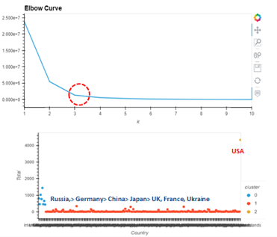
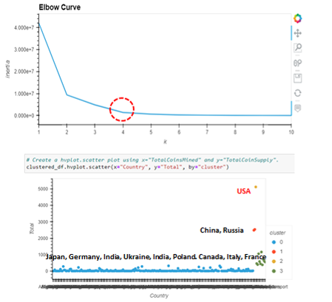
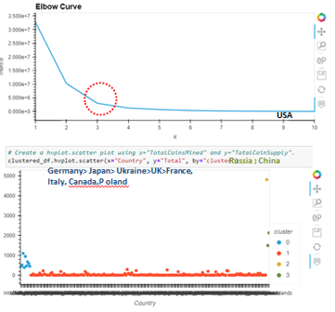
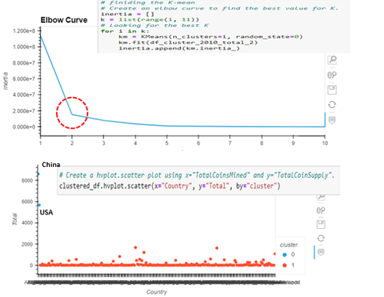
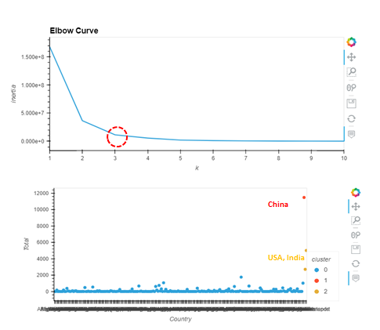
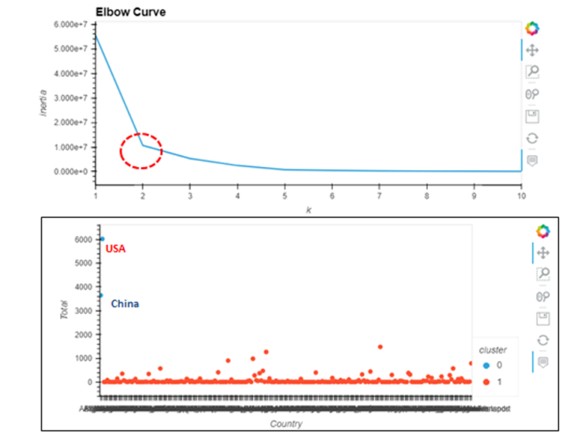
Result of K-means clustering
1970
1990
1980
2000
2010
2021

Slide 14
Discussion
Unsupervised learning benefits:
Learn from unlabeled data
Group data into optimal number of clusters by elbow curve
No manual data processing efforts needed
In the past 50 years, we observed:
There are clear clusters that exist in the data between low, medium and high emitting countries.
The large emitters changed from mostly European countries, to the US, and more recently developing countries like China and India.
Contribution:
Help policy makers understand the severity of the problem
Show historical trends easily
Identify large emitters for most effectiveness

Slide 15
Deep Neural Network
Deep neural networks can learn from large sets of input data, regardless of data complexity. We wanted to explore deep neural networks to see if it's a good use case for our dataset as well.

Slide 16
Data preparation
clean the dataset:
clean the missing data
drop non-numeric/ unnecessary features: such country code, per-capita
standardize the data with StandardScaler
Split the preprocessed data into
(1) our features and targets arrays
(2) training and testing dataset
Define the neural networks: Keras library
tuned number of neurons and hidden layers
model training : varying number of epochs
observe model loss and accuracy

Slide 17
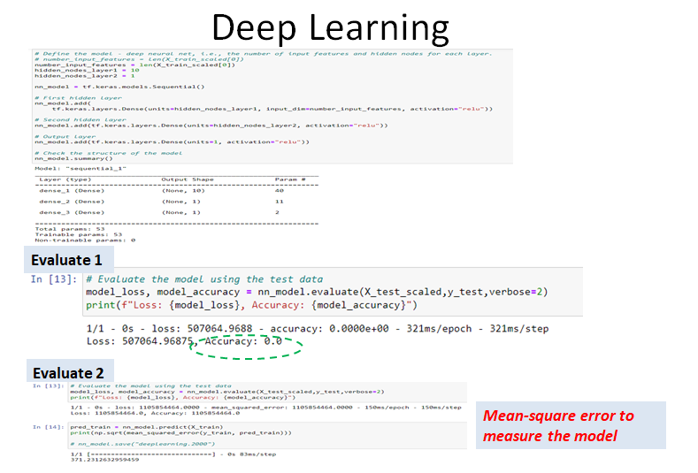
Discussion
In our case, the target variable is continuous, and the model loss function “binary_crossentropy” is not a good fit for the continuous data. This is shown in the result where the model accuracy is “ 0” after training.
Overcome this problem, we switched the loss function to “ mean square error”. We are able to show that the model is able to reduce the loss and improve accuracy after training.
For this case, it seems to be the case not the good fit because the continues data. We believe using liner regression can give us the best result for our dataset and goal.

Slide 18
Data Visualization
Country emission by year
Country emission by trend (1750-2021)
Global Prediction

Slide 19
Conclusion
The Paris climate accord goal of CO2 emission by 2030 will not be reached (40% CO2 emission reduction rate compared to the 1990's level). Almost triple the target rate set for 2030 (~16000 MtCO2) based on current assumptions.
China (30.9%), USA (13.5%), India (7.3%) are the world biggest polluters. These 3 countries emitted more than 51.7% (19189 MtCO2) of all global CO2 in 2021.
Trend of how emitting countries change throughout history. Largest emitter in 1970 were the USA, as well as in 2000, and eventually they were surpassed by China in 2021, with India close behind.

